Slide 1


Slide 2

Leonardo De Marchi

Slide 3
Reinforcement learning
Theory
PRACTICE
Basic definitions
Markov chain
Dynamic programming
SARSA
Q-Learning
Gradient methods
OpenAI
SARSA
Q-learning

Slide 4
Machine learning

Slide 5
MACHINE LEARNING
SUPERVISED
UNSUPERVISED
REINFORCEMENT

Slide 6
SUPERVISED - TRAINING
INPUT
OUTPUT

Slide 7
SUPERVISED - TRAINING
INPUT
MODEL
OUTPUT

Slide 8
SUPERVISED - scoring
INPUT
MODEL
OUTPUT

Slide 9
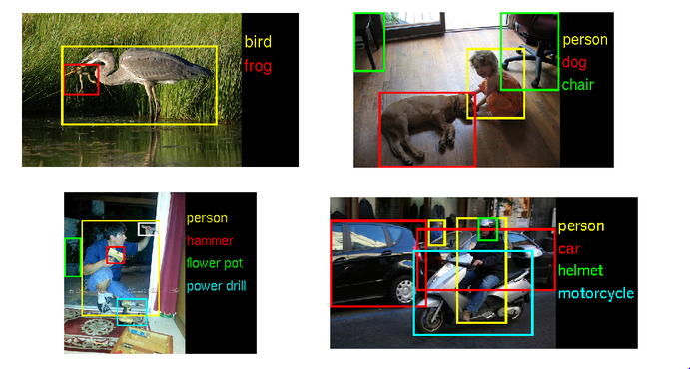
SUPERVISED
- scoring

Slide 10
unSUPERVISED
INPUT
MODEL
input clustered

Slide 11
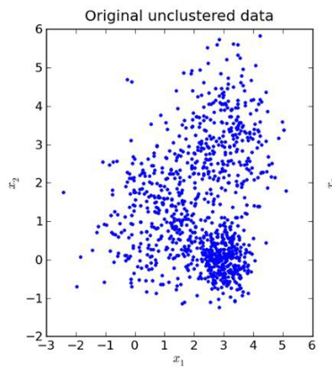
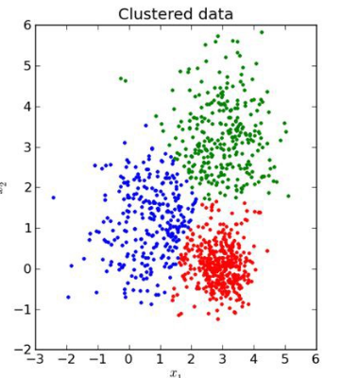
unSUPERVISED
INPUT
MODEL
input clustered

Slide 12
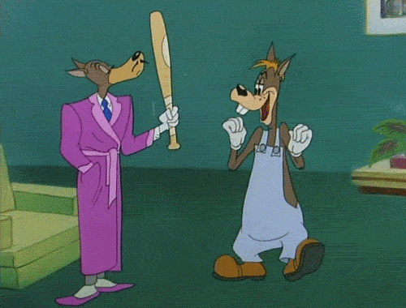
Reinforcement
learning

Slide 13
Reinforcement learning
agent
action
feedback
environment

Slide 14
applications

Slide 15
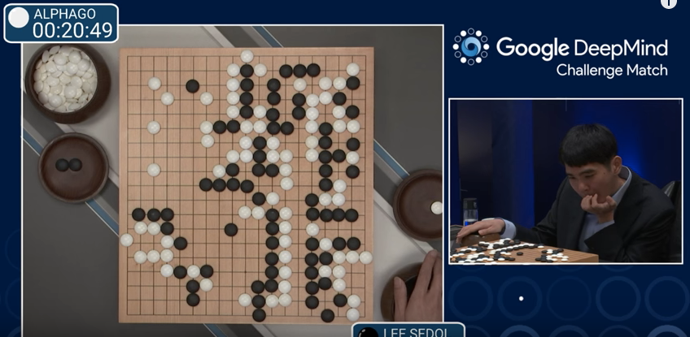
Alpha go

Slide 16
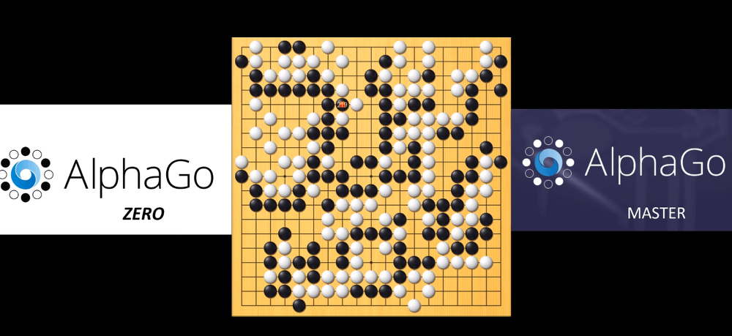
Alpha zero

Slide 17
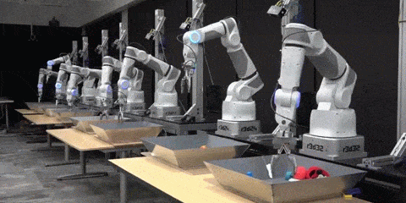
Robotic

Slide 18
Why it matters
Text summarisation engines
Dialog agents (text, speech)
Learning optimal treatment policies in healthcare
Online stocking
Scheduling
…

Slide 19
Why it matters
Learn how to make decisions to achieve a goal

Slide 20
Why it matters
Learn how to make decisions to achieve a goal by itself!

Slide 21
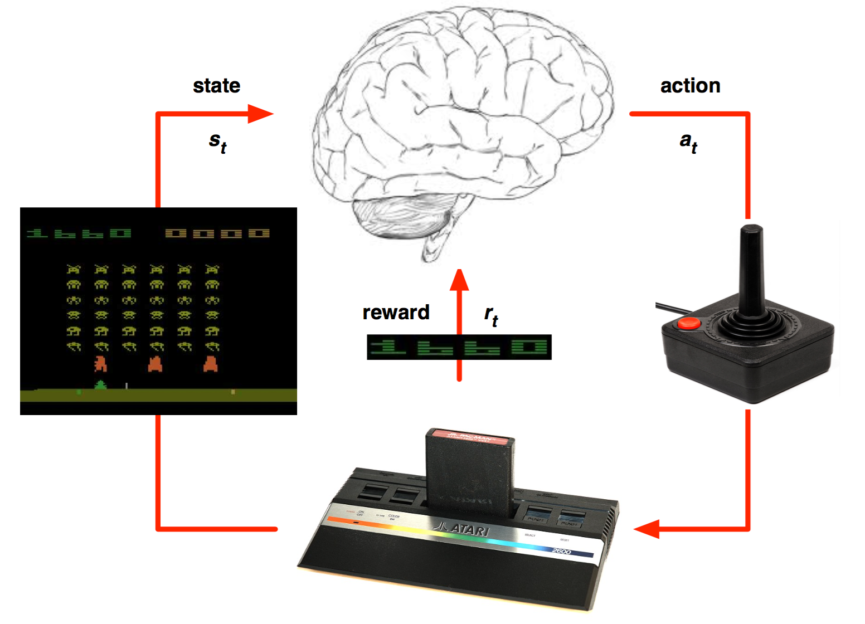
games

Slide 22
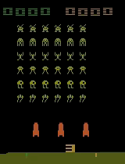
A2C

Slide 23
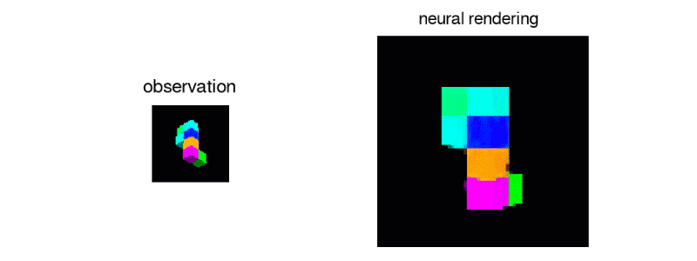
GQN

Slide 24
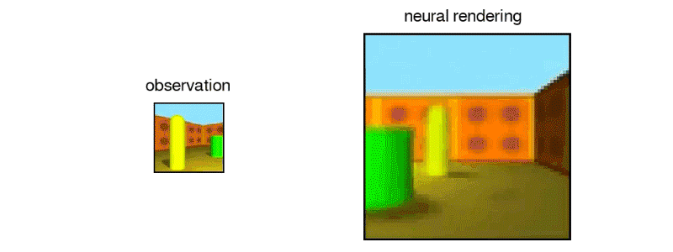
GQN

Slide 25
Interesting Applications
https://www.youtube.com/watch?v=oo0TraGu6QY
https://www.youtube.com/watch?time_continue=72&v=TmPfTpjtdgg
https://www.youtube.com/watch?v=UZHTNBMAfAA
https://www.youtube.com/watch?time_continue=118&v=eHipy_j29Xw

Slide 26
MULTI-ARMED BANDIT
Markov Decision Process with one state

Slide 27

Maximising
reward

Slide 28
Markov property
The following state depends only on the current state and action
The state must include all info of past agent-interaction environment that will make a difference in the future
Action: decision we want to learn how to make
p(s0,r|s,a) = Pr{St=s0,Rt=r|St 1=s,At 1=a},

Slide 29
Simple multi-armed Bandit
30%
77%
50%
Current Success Rate
Current Success Rate
Current Success Rate

Slide 30
Simple multi-armed Bandit
How many trial?
Stable?
30%
77%
50%
Current Success Rate
Current Success Rate
Current Success Rate

Slide 31
multi-armed Bandit
?%
Many options, variability
?%
?%
?%
?%
?%
Current Success Rate
?%
Current Success Rate
?%
?%
Current Success Rate
?%
?%
Current Success Rate
?%
?%
Current Success Rate
?%
?%
Current Success Rate
?%
?%
Current Success Rate
?%
?%
Current Success Rate
Current Success Rate
?%
?%
Current Success Rate
Current Success Rate
?%
?%
Current Success Rate
Current Success Rate
?%
?%
Current Success Rate
Current Success Rate
?%
?%
Current Success Rate
Current Success Rate
?%
77%
?%
Current Success Rate
Current Success Rate
?%
77%
?%
Current Success Rate
77%
Current Success Rate
Current Success Rate
?%
77%
Current Success Rate
Current Success Rate
Current Success Rate
?%
77%
Current Success Rate
Current Success Rate
30%
Current Success Rate
?%
77%
Current Success Rate
Current Success Rate
30%
Current Success Rate
?%
77%
Current Success Rate
Current Success Rate
30%
Current Success Rate
?%
77%
Current Success Rate
30%
Current Success Rate
?%
77%
Current Success Rate
30%
Current Success Rate
?%
30%
77%
Current Success Rate
Current Success Rate
Current Success Rate
Current Success Rate
77%
30%
Current Success Rate
Current Success Rate
Current Success Rate
77%
30%
Current Success Rate
Current Success Rate
Current Success Rate
77%
30%
Current Success Rate
Current Success Rate
Current Success Rate
77%
30%
Current Success Rate
Current Success Rate
Current Success Rate
77%
30%
Current Success Rate
Current Success Rate
77%
30%
Current Success Rate
Current Success Rate
77%
30%
Current Success Rate
Current Success Rate
30%
Current Success Rate
Current Success Rate
30%
Current Success Rate
Current Success Rate
30%
Current Success Rate
Current Success Rate
30%
Current Success Rate
Current Success Rate
30%
Current Success Rate
Current Success Rate
30%
Current Success Rate
Current Success Rate
Current Success Rate
Current Success Rate
Current Success Rate
Current Success Rate

Slide 32
Exploration vs Exploitation
We want
MAB
Maximise our total reward
Explore different solutions to find the best one
Estimate the payoff for each option
Takes the best option but sometimes explore others

Slide 33
Example - Newspaper Headlines
Disneyland increases prices by 67% in 10 years
Disneyland increases prices
You will never believe what Disneyland did

Slide 34
Example - Newspaper Headlines
Disneyland increases prices by 67% in 10 years
Disneyland increases prices
You will never believe what Disneyland did
Age band 1
Age band 2
Age band 3

Slide 35
Algorithms
Greedy
𝜀-greedy
Thompson sampling

Slide 36
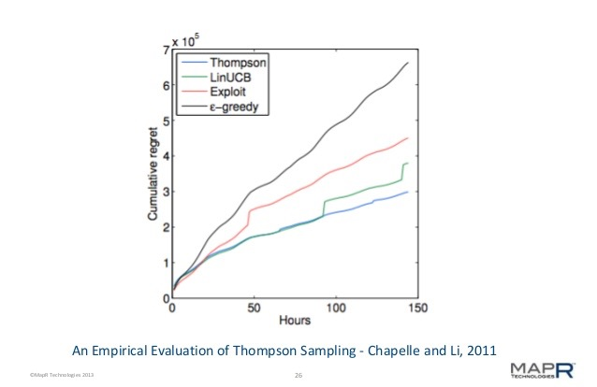
Thompson Sampling
Best solution: Thompson Sampling
Regret = sum of all
differences between
reward returned by the
strategy taken and best
possible reward

Slide 37
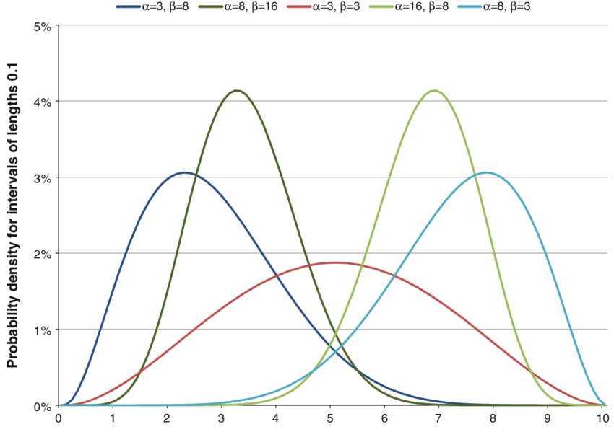
Thompson Sampling

Slide 38
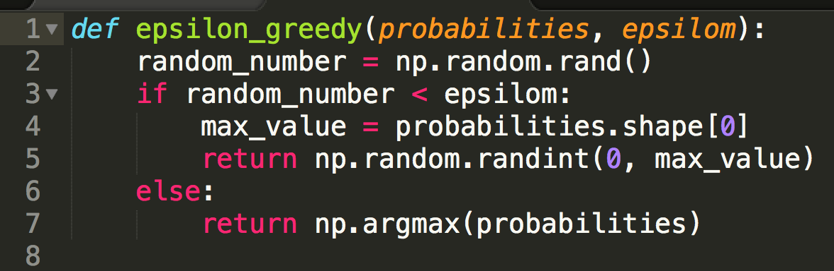
𝜀-greedy

Slide 39
our problem

Slide 40
The Problem
agent
action
feedback
environment

Slide 41

Environment

Slide 42
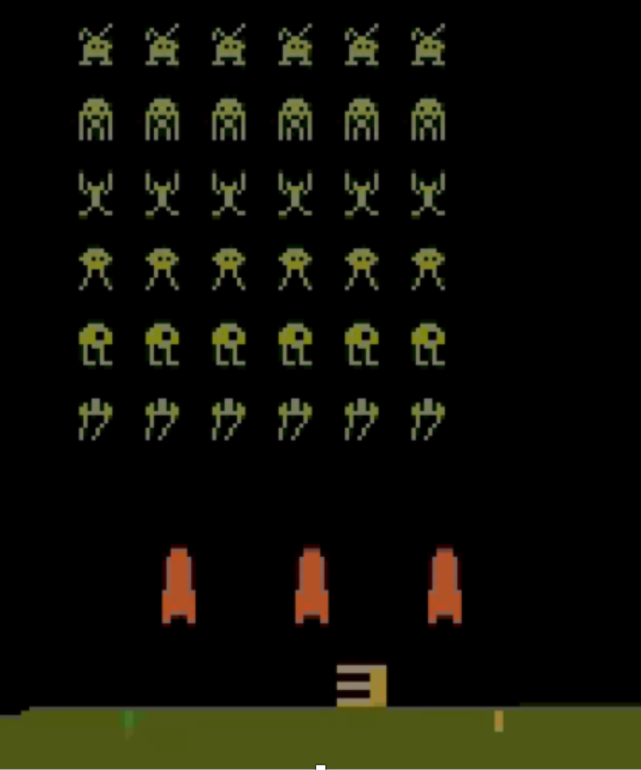
Environment
Anything that cannot be changed arbitrarily by the agent is considered environment

Slide 43
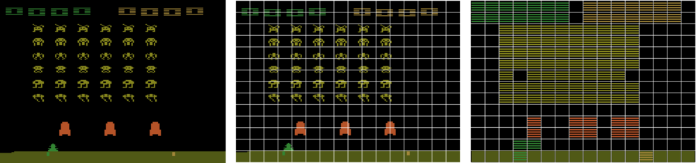
Environment
More complex than MAB
Multiple states
Complex reward function

Slide 44

Feedback
Returned by the environment
+10
+1

Slide 45
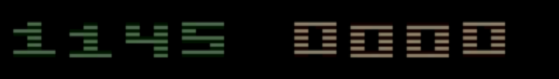
Goal
Maximise the total reward

Slide 46
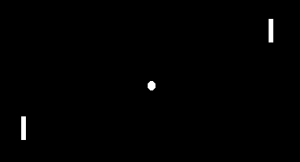
Total Reward

Slide 47
Value-based methods
Estimate the value function
Policy is implicit (eg 𝜀-greedy)
i.e. Sarsa, Q-learning
Value-based
methods

Slide 48
Policy-Based methods
No value function
Estimate the policy
For simpler problems
i.e. Reinforce
Policy-based methods

Slide 49
Actor Critic Models
Actor-critic methods
Value-based
methods
Policy-based methods

Slide 50
Code session 1:
gym exploration

Slide 51
OpenAi’s gym basics
Import: import gym
Load environment: env = gym.make(‘SpaceInvaders-v0’)
Start episode: env.reset
Display the environment: env.render()
Evaluate an action: env.step(action)
It returns an observation, a reward, if it’s finished and some info on the environment
observation, reward, done, info = env.step(action)
You can start with 20 episodes with 100 time steps each

Slide 52
Markov Decision Process

Slide 53
Markov Decision Process
at
Agent
Environment
Rt
Rt+1
st+1
St

Slide 54
Markov Decision Process
at
Agent
Environment
Rt
Rt+1
st+1
St
p(s’,r|s,a) = Pr{St=s’, Rt=r | St-1=s, At-1=a}

Slide 55
Markov property
The following state depends only on the current state and action
The state must include all info of past agent-interaction environment that will make a difference in the future
Action: decision we want to learn how to make
p(s0, r|s, a) = Pr{St=s0, Rt=r | St+1=s, At+1=a}

Slide 56
Goal - Episodic
Goal is the maximisation of the expected value of the cumulative sum of a received scalar signal (called reward).
The time limit is well defined
G_{t} ≐ R_{t+1} + R_{t+2} + R_{t+3} + ··· + R_{T}

Slide 57
Goal - Continuous
Goal is the maximisation of the expected value of the cumulative sum of a discounted received scalar signal (called reward).
G_{t} ≐ R_{t+1} + 𝛾R_{t+2} + 𝛾²R_{t+3} + ··· =𝛴_{k}∞ 𝛾^{k-t-1}R_{k}
Where the discount rate 𝛾 0 ≤ 𝛾 ≤ 1

Slide 58
Goal - Unified Notation
Goal is the maximisation of the expected value of the cumulative sum of a discounted (or not) reward.
Added a “catch all” state for continuous tasks.
R₁₌₊₁
R₂₌₊₁
R₃₌₊₁
R₄₌₀
S0
S1
S2
R₅₌₀
…

Slide 59
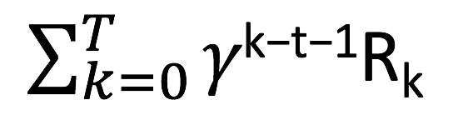
Goal - Unified Notation
Goal is the maximisation of the expected value of the cumulative sum of a discounted (or not) reward till state T
Unified formula for total rewards: G_{t} ≐
R₁₌₊₁
R₂₌₊₁
R₃₌₊₁
R₄₌₀
S0
S1
S2
R₅₌₀
…
Where 0 ≤ 𝛾 ≤ 1 and T can be finite or infinite

Slide 60
POLICY BASED METHODS

Slide 61
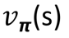
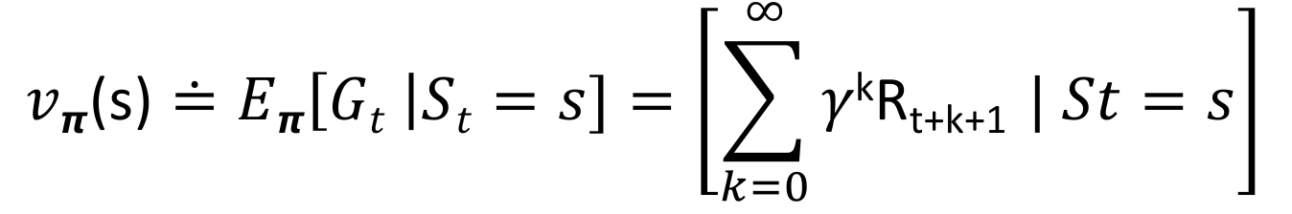
Policies
𝞹(a|s) ≐ Probability of taking action a from A_{t} under state s from S_{t}
The value function of a state s under a policy 𝞹 is the expected return when starting in s and following 𝞹 afterwards.
For MDP:
E_{𝞹} is the Expected value under policy 𝞹 and starting on state s
This function consider only the current state

Slide 62
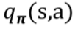
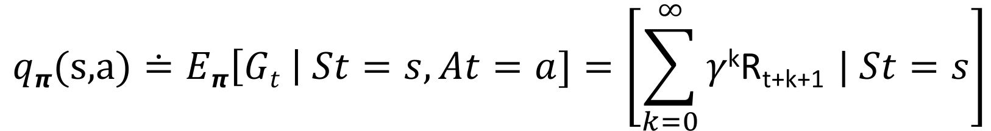
Policies
We can define the same also for the value function depending on both status and action taken.
The value function of an action-value function for policy 𝞹 is the expected return when starting in s, taking action a and following 𝞹 afterwards
max𝞹𝑞𝞹(s, a) is the action-value function

Slide 63
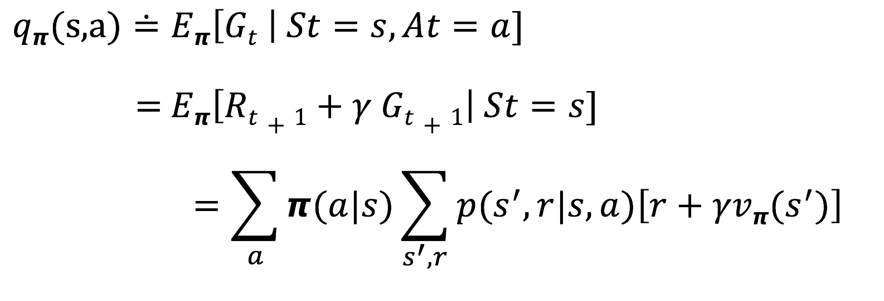
Bellman Equation
The value of the start state must be equal to the discounted value of the expected next state plus the expected reward

Slide 64
Dynamic Programming
Algorithms to compute optimal policies
Needs a perfect model of the environment as a MDP
Not RL, but it’s an useful foundation for it
Main idea: Use value functions to organise and structure the search for good policies

Slide 65
Policy Iteration
Initialisation
Policy evaluation using the value function
Policy Improvement

Slide 66
Value Iteration
Initialisation
Value evaluation
Value Improvement

Slide 67
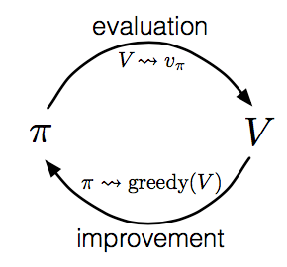
Generalised policy iteration

Slide 68
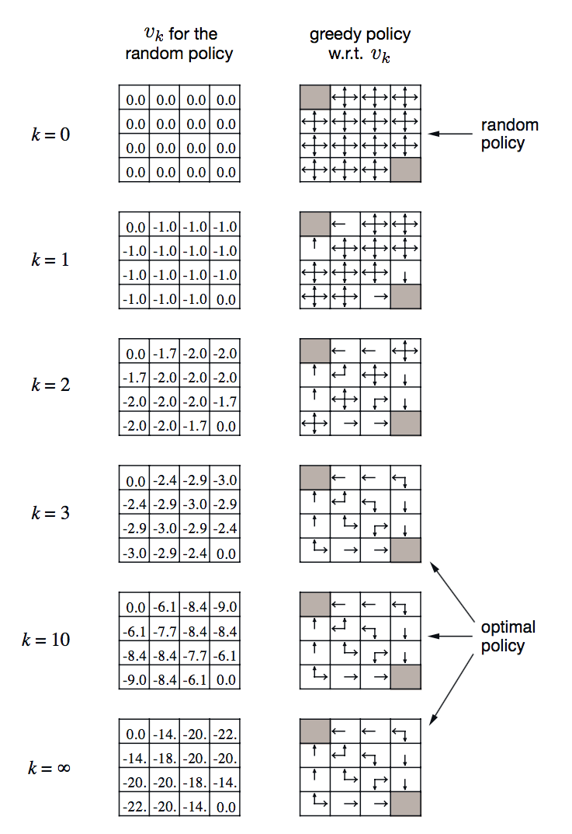
Policy/value function
We compute the value function to compute better policies
Rt = -1
on all transitions
r(s, a, s’) = -1
Using Bellman equation we evaluate

Slide 69
Optimality
We define 𝑞∗(s, a) as the optimal policy 𝑞∗(s, a) ≐ max𝞹𝑞𝞹(s, a)
It converges at ∞
In real world we just need good approximations

Slide 70
Value-based methods
Estimate the value function
Policy is implicit (eg 𝜀-greedy)
i.e. Sarsa, Q-learning
Value-based
methods

Slide 71
Temporal-Difference Learning
Can learn directly from raw experience without a model of the environment’s dynamics.
Like DP, TD methods update estimates based in part on other learned estimates, without waiting for a final outcome (they bootstrap)

Slide 72
Exploration vs Exploitation
An algorithm:
wants to take the best decision
wants to explore to find the best decision

Slide 73
Policy update
On-policy (i.e. SARSA)
Agent commits to always explore and find the best policy that still explore
Off-policy (i.e. Q-learning)
The agent learns a deterministic optimal policy that might be unrelated from the policy followed

Slide 74
sarsa
Episode: alternating sequence of state/action pairs
SARSA is a TD technique
R_{t+1}
St
St+1
A_{t}
A_{t+1}

Slide 75
Temporal Difference (TD)
TD-learning estimates the value function directly (on-policy)
Doesn't try to learn the underlying MDP
Keep an estimate of V π(s) in a table
Update these estimates as we gather more experience
Estimates depend on the exploration policy (e.g. 𝜀-greedy) and π
Generate a policy from the Value Function (e.g. using 𝜀-greedy)
V π(s) is guaranteed to converge to V *(s) after an infinite number of experiences

Slide 76
Sarsa algorithm
Algorithm parameters: step size 𝛼 ∈(0, 1], small 𝜀 > 0
Initialise Q(s,a), for all s ∈ S+, a ∈ A(s), arbitrarily except that Q(terminal,·) = 0
Loop for each episode:
Initialise S
Choose A from S using policy derived from Q (e.g., 𝜀-greedy)
Loop for each step of episode:
Choose A’ from S’ using policy derived from Q (e.g., 𝜀-greedy) Take action A, observe R, S’ Q(S, A) ⟵ Q(S, A) + 𝛼[R +𝛾 Q(S’, A’) - Q(S, A)] S ⟵S’; A ⟵ A’; until S is terminal

Slide 77
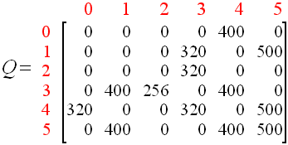
Value function (Q-matrix)

Slide 78
Policy
𝞹(a|s) ≐ Probability of taking action a from A_{t} under state s from S_{t}
Use policy and expected return to take action
Estimate the value function
Policy is implicit (eg 𝜀-greedy)
i.e. Sarsa, Q-learning
STATES
ACTIONS

Slide 79
Policy
𝞹(a|s) ≐ Probability of taking action a from A_{t} under state s from S_{t}
STATES
ACTIONS

Slide 80
Value function (Q-matrix)
S0
S2
0
0
0
S1
S3
320
STATES
0
S4
500
S5
ACTIONS

Slide 81
POLICY – Value function + 𝜀-greedy
Q(S, A) ⟵ Q(1, 3) + 𝛼[R +𝛾 Q(S’, A’) - Q(1, 3)]
S ⟵S’; A ⟵ A’;
S0
S2
0
0
0
S1
S3
320
STATES
0
S4
500
S5
ACTIONS

Slide 82
Exercise: Frozen Lake - Actions
S

Slide 83
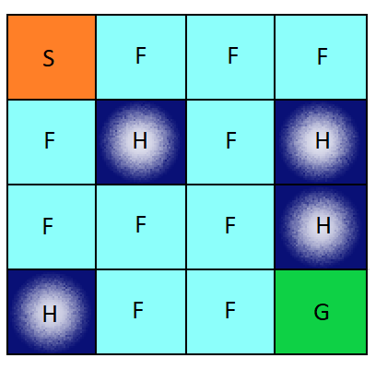
Exercise: Frozen Lake - Environment

Slide 84
Code session 2:
Frozen lake
with sarsa

Slide 85
Q-learning
Algorithm parameters: step size 𝛼 ∈(0, 1], small 𝜀 > 0
Initialise Q(s,a), for all s ∈ S+, a ∈ A(s), arbitrarily except that Q(terminal,·) = 0
Loop for each episode:
Initialise S
Choose A from S using policy derived from Q (e.g., 𝜀-greedy)
Loop for each step of episode:
Choose A’ from S’ using policy derived from Q (e.g., 𝜀-greedy) Take action A, observe R, S’ Q(S, A) ⟵ Q(S, A) + 𝛼[R +𝛾 max Q(S’, a) - Q(S,A)] max Q(S’, a) is the estimated optimal future value
S ⟵S’ A ⟵ A’; until S is terminal
Notes:
{\displaystyle \gamma } (the discount factor) is a number between 0 and 1 ({\displaystyle 0\leq \gamma \leq 1}) and has the effect of valuing rewards received earlier higher than those received later
An episode of the algorithm ends when state s_{t+1} is a final or terminal state. However, Q-learning can also learn in non-episodic tasks. If the discount factor is lower than 1, the action values are finite even if the problem can contain infinite loops.

Slide 86
Code session 3:
Frozen lake
with q-learning

Slide 87
Gradient methods:
Deep reinforcement learning

Slide 88
Policy-Based methods
No value function
Estimate the policy
For simpler problems
i.e. Reinforce
Policy-based methods

Slide 89
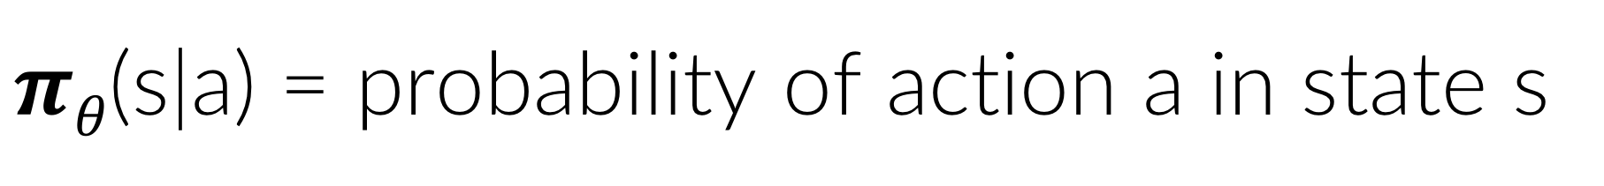
Policy gradients
𝝅𝜽(s|a)
action
feedback
environment
$πθ$(s|a) = probability of action a in state s

Slide 90
Policy bASED METHODS
Policy
E=[$\max_{θ}\sum_{t=0}^{H}{R\left(st\right)|}πθ]{}$
If we change an action we have a big impact
Changing the action distribution will have a smaller impact

Slide 91
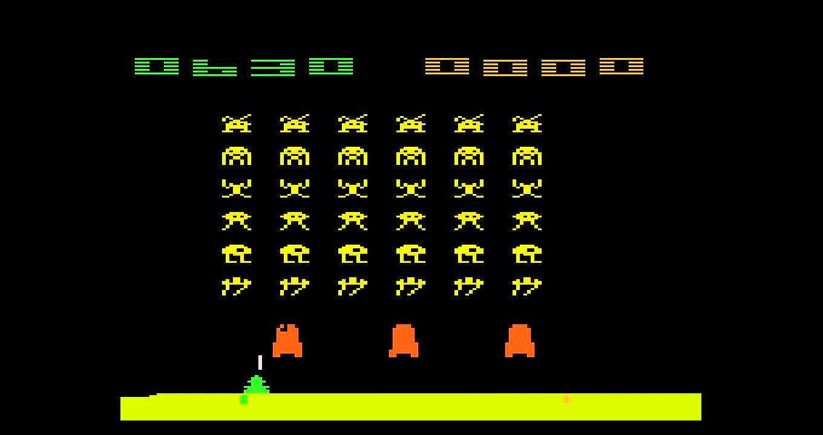
Policy-Based methods

Slide 92
Deep RL Algorithm
Some approaches do not use gradient Hill climbing Simplex Genetic algorithms …
Greater efficiency often possible using gradient

Slide 93
Gradient methods
Perform policy gradient directly on the performance surface underlying the chosen parametric policy class
Solve simpler problems, faster
Innate exploration by his stochastic nature
Can be used together with supervised learning

Slide 94
Deep learning
Perceptron

Slide 95
Deep learning
Input layer
First Layer
Second layer
Output layer

Slide 96
Deep learning
Input layer
First Layer
Second layer
Output layer

Slide 97
Deep learning
Input layer
First Layer
Second layer
Output layer

Slide 98
Deep learning
Input layer
First Layer
Second layer
Output layer

Slide 99
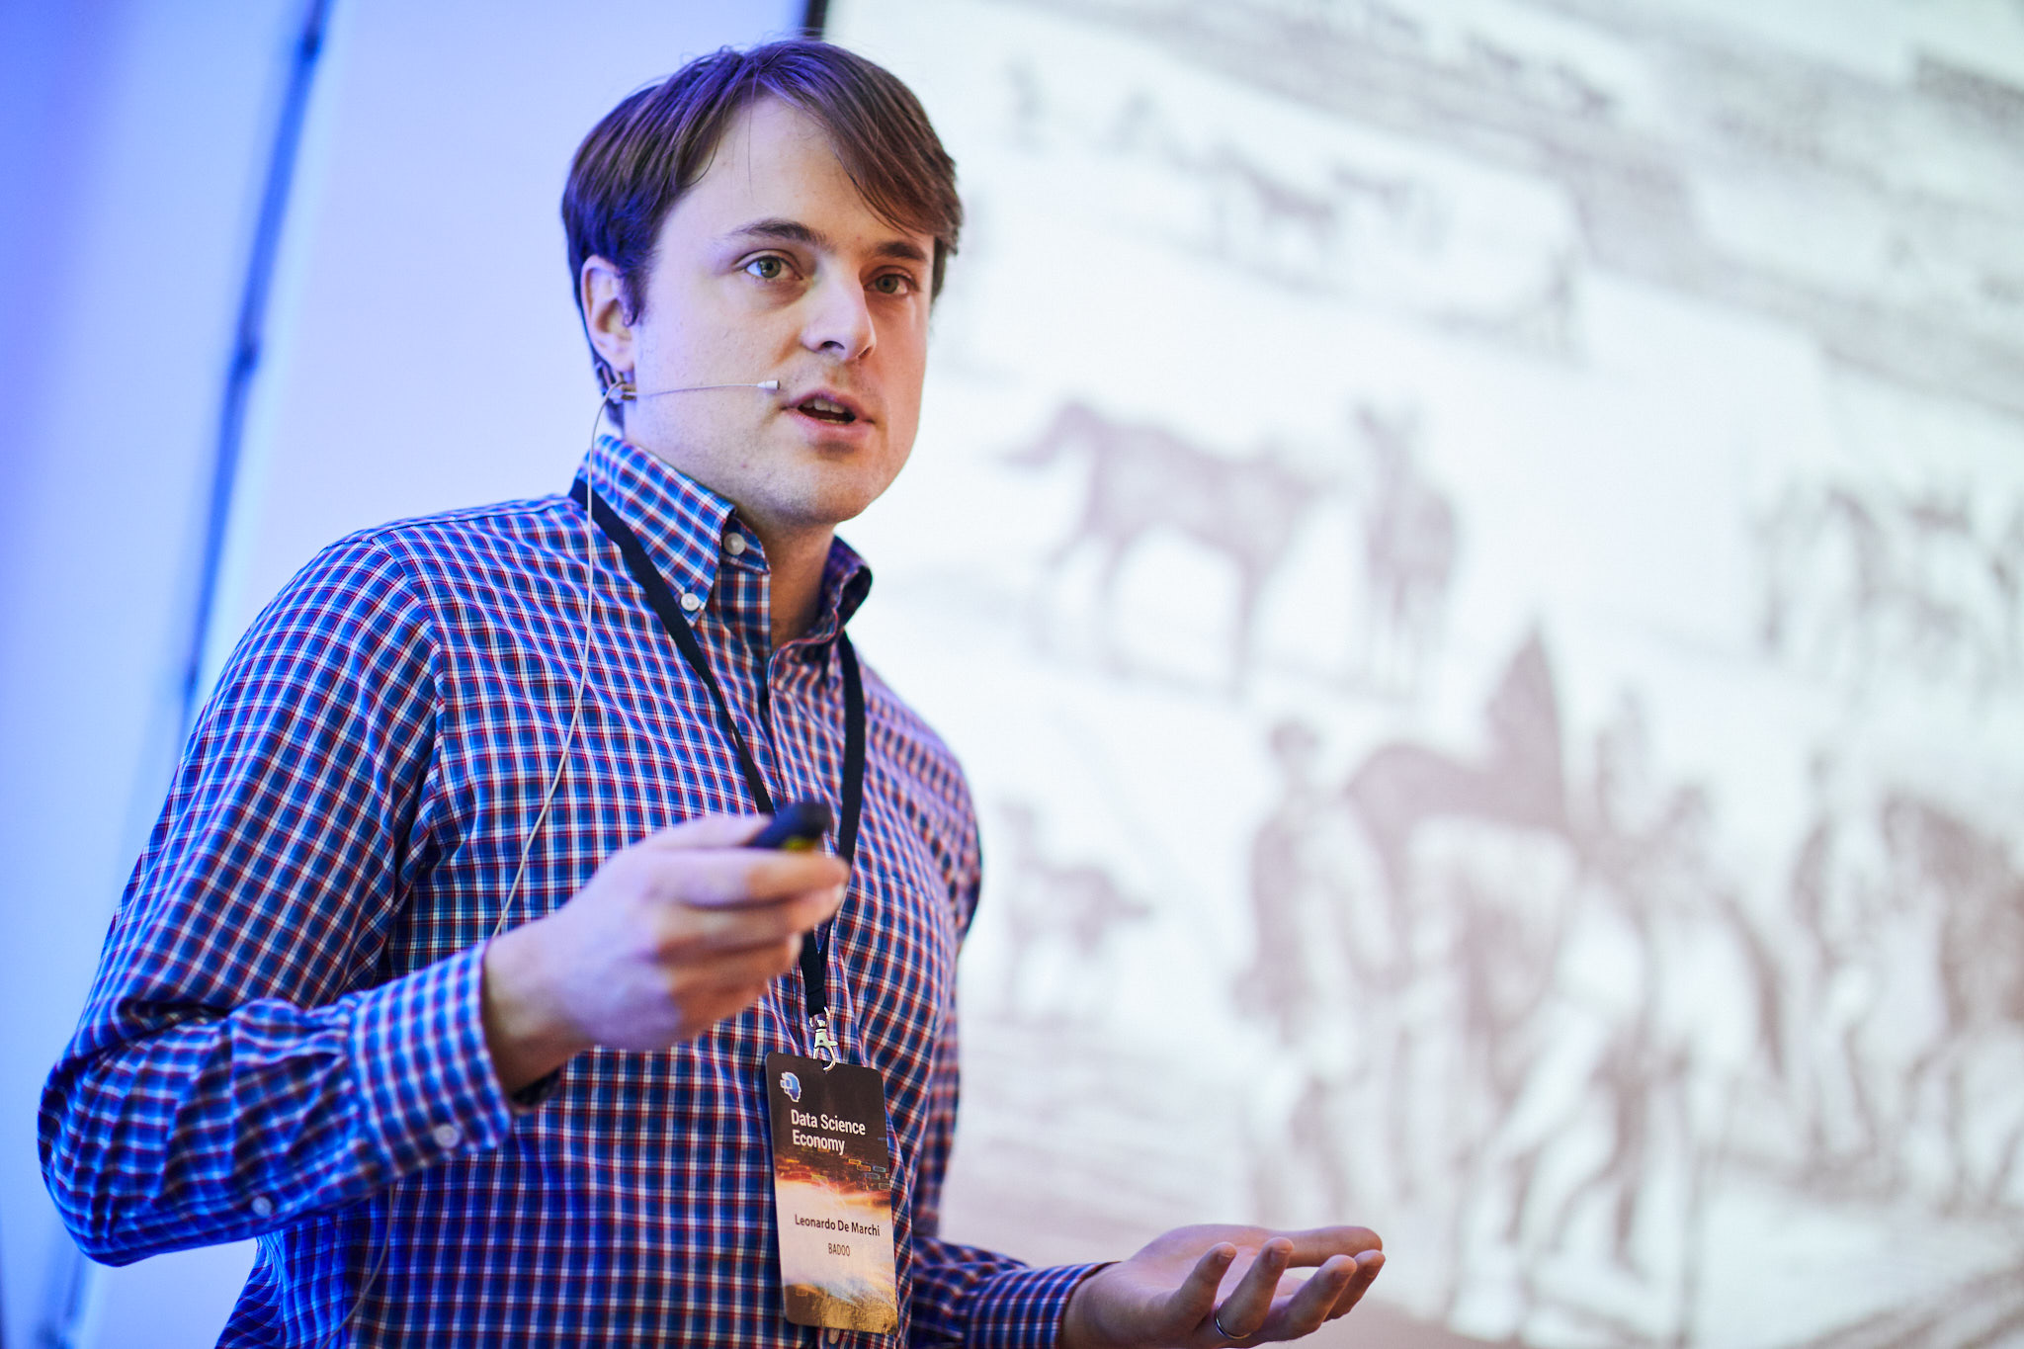
Deep learning
0.77
Leonardo Da Vinci
0.11
Leonardo De Marchi
0.12
Leonardo DI Caprio
Input layer
First Layer
Second layer
Output layer

Slide 100
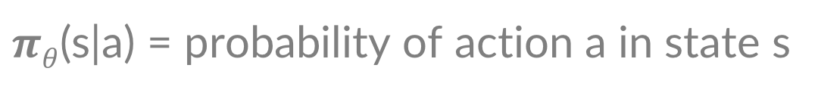
Policy gradients
𝝅𝜽(s|a)
action
feedback
environment
$πθ$(s|a) = probability of action a in state s

Slide 101
Deep learning
0.77
Leonardo Da Vinci
0.11
Leonardo De Marchi
0.12
Leonardo DI Caprio
Input layer
First Layer
Second layer
Input layer

Slide 102
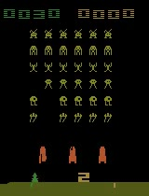
Dataset
Prob Action 1
Prob Action 2
Prob Action 3
State
Softmax Output
Reward

Slide 103
Dataset
State
Action taken
Reward

Slide 104
Deep Reinforcement learning
0.77
Action 1
0.11
X
Reward
Action 2
0.12
Action 3
Input layer
First Layer
Second layer
Output layer

Slide 105
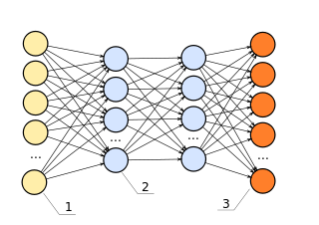
Policy gradients
Actions
𝝅𝜽(s|a)
action
feedback
environment

Slide 106
Value-based methods
Estimate the value function
Policy is implicit (eg 𝜀-greedy)
i.e. Sarsa, Q-learning
Value-based
methods

Slide 107
Policy-Based methods
No value function
Estimate the policy
For simpler problems
i.e. Reinforce
Policy-based methods

Slide 108
Actor Critic Models
Actor-critic methods
Value-based
methods
Policy-based methods

Slide 109
Deep RL Algorithm
Get the state from the environment.
Feed forward our policy network to predict the probability of each action,
Sample from this distribution to choose which action to take
Receive the reward and the next state state.
Store this transition sequence of state, action, reward, for later training.
Repeat the previous steps till the episode end.
Once the episode is over, we train our neural network to learn from our stored transitions using our reward guided loss function.
Play next episode and repeat steps above.

Slide 110
Actor Critic Models
In TD models:
TD only evaluates a particular policy
Does not learn a better policy
We can change the policy as we learn
In AC models:
Policy is the actor
Value-function estimate is the critic
Success is generally dependent on the starting policy being “good enough”

Slide 111
Actor Critic Models
Critic
Values
Actor
action
reward
state
environment

Slide 112
Actor Critic Models
Actor: takes in the current environment state and determines the best action to take from there
Critic plays the “evaluation” role from the DQN by taking in the environment state and an action and returning a score that represents how apt the action is for the state.
Allows actor critic to be more sample efficient via TD updates at every step.
Notes:
Value based methods such as Q learning suffer from poor convergence, as you are working in value space and a slight change in your value estimate can push you around quite substantially in policy space.
Policy based methods, both policy search and gradient, work directly in policy space and have much smoother learning curves and performance improvement guarantees with every update the drawback with this method is that it tends to converge to local maximas (in policy based methods you are maximizing the expected reward by searching in the policy space) and suffer from high variance, sample inefficiency.

Slide 113
Actor Critic Models
Implement generalized policy iteration - alternating between a policy evaluation and a policy
Actor improvement: aims at improving the current policy
Critic evaluation: evaluates the current policy If the critic is modelled by a bootstrapping method it reduces the variance so the learning is more stable than pure policy gradient methods
Notes:
Value based methods such as Q learning suffer from poor convergence, as you are working in value space and a slight change in your value estimate can push you around quite substantially in policy space.
Policy based methods, both policy search and gradient, work directly in policy space and have much smoother learning curves and performance improvement guarantees with every update the drawback with this method is that it tends to converge to local maximas (in policy based methods you are maximizing the expected reward by searching in the policy space) and suffer from high variance, sample inefficiency.

Slide 114
Reinforcement learning
Theory
PRACTICE
Basic definitions
Markov chain
Dynamic programming
SARSA
Q-Learning
Gradient methods
OpenAI
SARSA
Q-learning

Slide 115
Questions

Slide 116

Thank you!
You can contact me at
www.ideai.io info@ideai.io
Next: https://www.eventbrite.co.uk/e/modern-machine-learning-and-deep-learning-2-day-course-tickets-49603205523?aff=ebdssbdestsearch
Use discount code: IDEAIFORME

